Slide 2
DIGITAL IMAGE PROCESSING PRESENTATION
Instructor: Assoc Prof. Tran Thi Thanh Hai Assoc Prof. Le Thi Lan

Slide 3

IMAGE DEBLURRING
NGUYEN QUANG ANH - 20213564

Slide 4
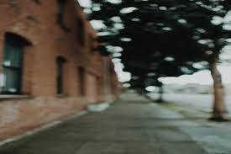
WHAT IS BLUR IN IMAGE
Image blur is an unfavorable loss of bandwidth that reduces image quality and is difficult to avoid.
Blur is produced by both atmospheric instability and improper camera settings. Noise alters the recorded image in addition to blur effects.

Slide 5


UNNECESSITY OF BLUR
The capability to extract meaningful information from blurry images holds immense importance for diverse applications.
Blur in computer vision refers to the loss of sharpness or clarity in images or videos. It can occur due to different factors.

Slide 6
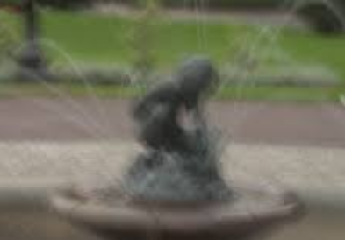
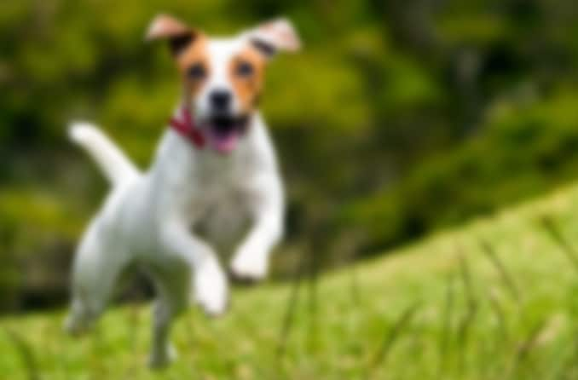
WHAT IMAGE DEBLURRING CAN DO
Image deblurring is a sort of image restoration in which distortions are removed to restore clear images. One sort of distortion is blurring artefacts.
Deblurring is the process of recovering a clear picture from a blurred input. Because it is inherently an inverse problem, there is no one unique solution; it is thus an ill-posed problem.

Slide 7


OUR METHOD
Image Loading
GMM Segmentation
Optimization Setup
IRLS Optimization
Final Visualization

Slide 8
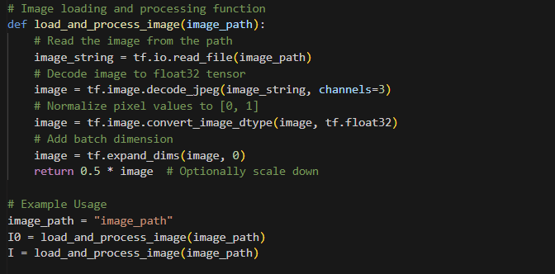
IMAGE LOADING
This section is responsible for loading and initial processing of the image.

Slide 9
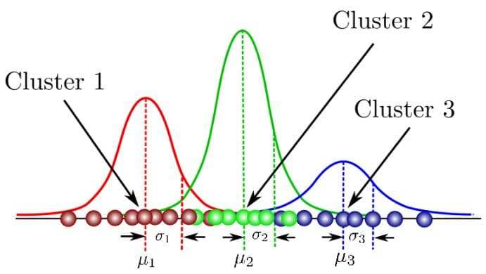
GAUSSIAN MIXTURE MODEL (GMM)
Gaussian Mixture is a function that includes multiple Gaussians equal to the total number of clusters formed. Each Gaussian in the mixture carries some parameters which are:
- A mean, that defines the center.
- A covariance, that defines the width.
- A probability.

Slide 10
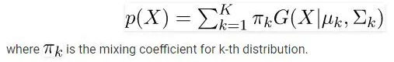
GAUSSIAN MIXTURE MODEL (GMM)
Since there are three( k=3) clusters and the probability density is defined as a linear function of densities of all these k distributions.
As there will be some n number of sample points in k(th) cluster and the parameters cannot be estimated in closed form
=> EM algorithm finds the maximum-likelihood estimates for model parameters when the data is missing or incomplete or has some variables hidden. This algorithm chooses some random values for the missing data points and calculates a new set of data. These values are used to filling the missing points until the values get first.

Slide 11
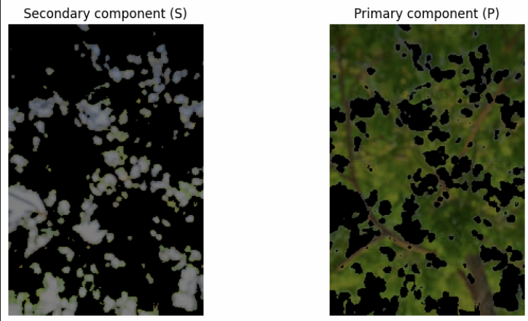
EM ALGORITHM AND TWO-COLOR GMM

Slide 12
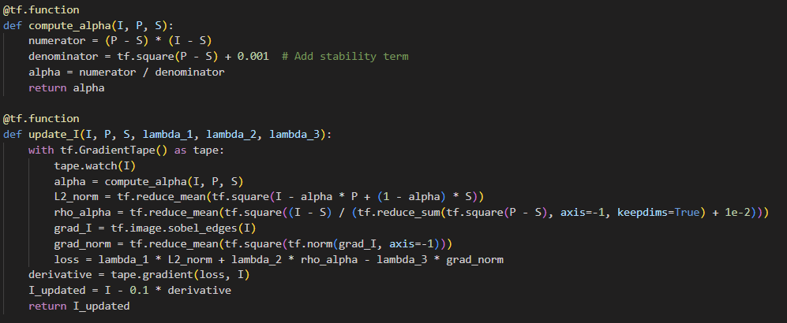
OPTIMIZATION SETUP
This section sets up the necessary components for the optimization process, including initialization and defining regularization parameters.

Slide 13
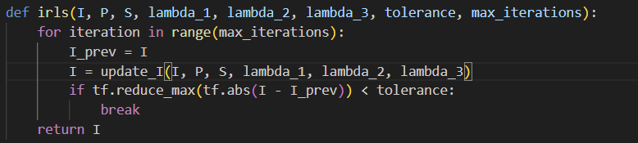
IRLS OPTIMIZATION
The Iteratively Reweighted Least Squares (IRLS) optimization is then performed. This step iteratively updates the image based on the optimization criteria set in the previous step.

Slide 14
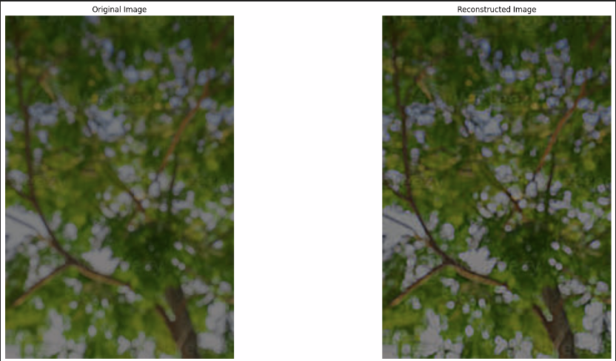
FINAL VISUALIZATION
Finally, the optimized image is visualized alongside the original image for comparison.

Slide 15
REFERENCE
https://vision.cornell.edu/se3/wp-content/uploads/2014/09/Joshi-CVPR09.pdf
https://www.cronj.com/blog/gaussian-mixture-model-in-image-processing-explained/
https://towardsdatascience.com/iterated-reweighted-least-squares-and-glms-explained-9c0cc0063526

Slide 16
THANK YOU !

